Slide 1
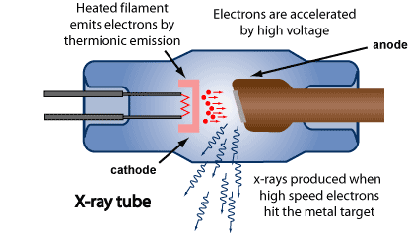
IX. X-ray diffraction
9-1. Production of X-ray
Vacuum, thermionic emission, high voltage,
and a target
http://www.arpansa.gov.au/radiationprotection/basics/xrays.cfm

Slide 2
Energetic electron hitting a target
Braking radiation
Characteristic
X-ray
Auger electrons

Slide 3
(i) Braking radiation:
Target
v₂
v₀
v₁
V₂ > V₁
I
V₂
V₁
λ
Short wavelength limits

Slide 4
(ii) characteristic radiation
Nonradiative
transition
}
M
{
3S
Characteristics
X-Ray photon
Auger
electron
2P
L₃
L₃
L₃
L₂
L₂
L₂
2S
L₁
L₁
L₁
Excitation
source
K_{β}
K_{α2}
K_{α1}
Radiative
transition
1S
K
K
k
The figure in Note is wrong!

Slide 5
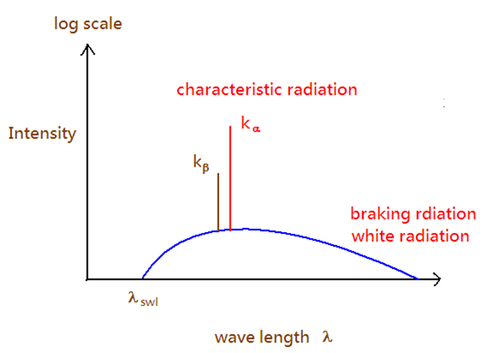
a typical X-ray spectrum

Slide 6
(iii) Cu K_{α} radiation
Cu K_{α1} =1.54050 Å
Cu K_{α2} =1.54434 Å
Cu K_{α} =1.5418 Å
High angle line
Low angle line
Why we can resolve K_{α1} and K_{α2} double
lines at high angle?

Slide 7
9-2. X-ray diffraction
(i) Laue method: λ variable, white
radiation, θ fixed
(ii) Diffractometer method: λ fixed,
characteristic radiation, θ variable
(iii) Powder method: λ fixed, characteristic
radiation, θ variable
(iv) Rotating crystal method: λ fixed,
characteristic radiation, θ variable

Slide 8
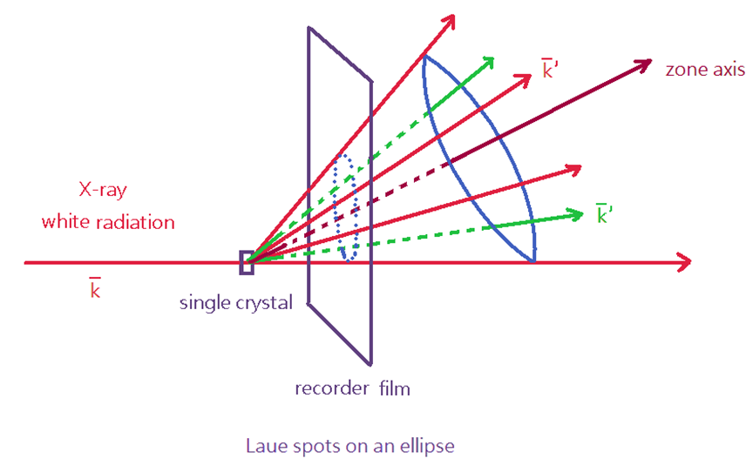
9-2-1. Laue method

Slide 9
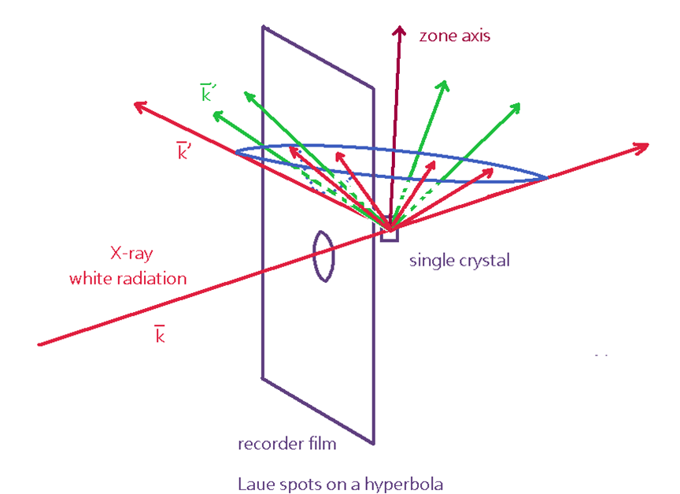

Slide 10
(1) Laue condition
Von Laue derived the “ Laue conditions “ in
1912 to express the necessary conditions for
diffraction.
Assume that are three crystal lattice vectors in a crystal
Similarly,

Slide 11
Very often , the Laue conditions are expressed as
Unit vector
The three Laue conditions must be satisfied
simultaneously for diffraction to occur.
The physical meaning of the 3 Laue conditions
are illustrated below.

Slide 12
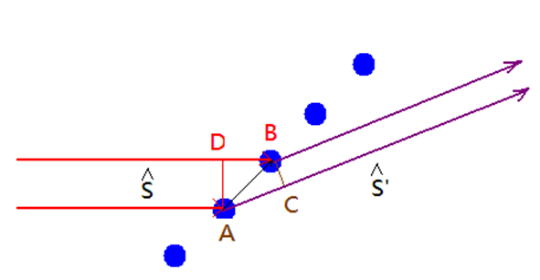
1st Laue conditions
The path difference
between the waves
equals to
The criterion for diffraction to occur is
or
integer

Slide 13
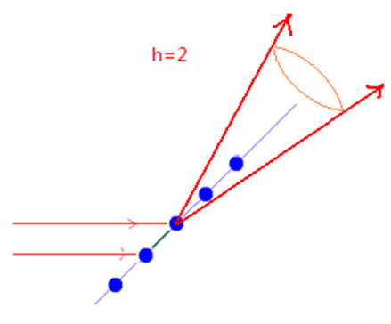
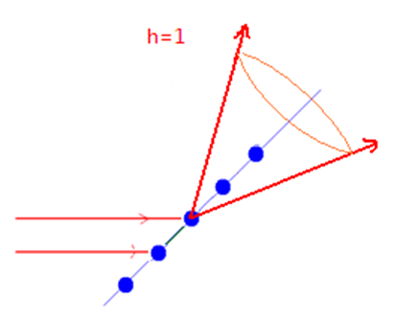
For 1-dimensional crystal
Cones of diffracted beams for different h

Slide 14
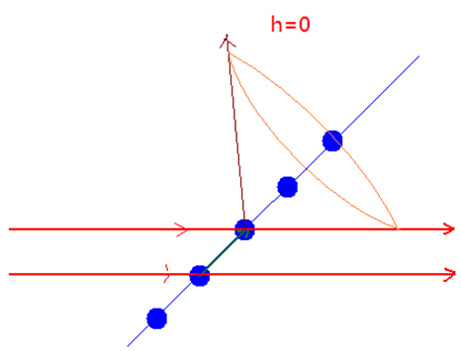
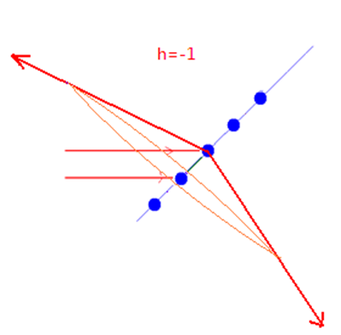

Slide 15
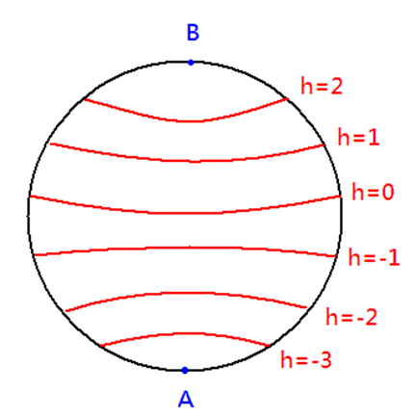
Stereographic projection representation for 1-D crystals
The projection of diffracted beams for h = 0 is a great circle if the incident beam direction is perpendicular, i.e.
The projection of diffracted beams for h = 0 is a small circle if the incident beam direction is not perpendicular

Slide 16
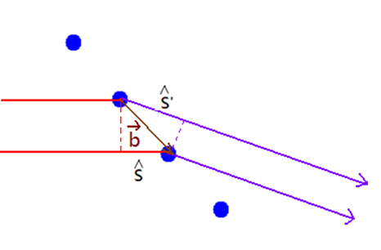
2nd Laue condition
integer

Slide 17
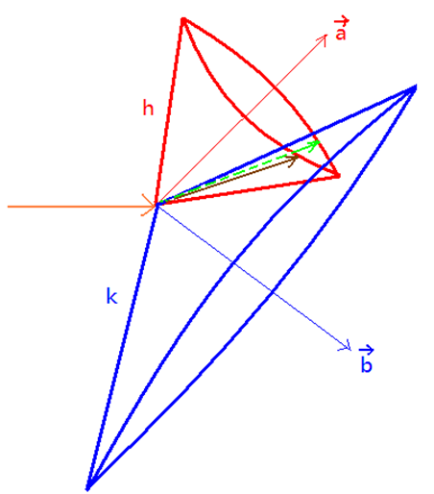
For a two-dimensional crystal
The 1st and 2nd conditions are simultaneously satisfied only along lines of intersection of cones.

Slide 18
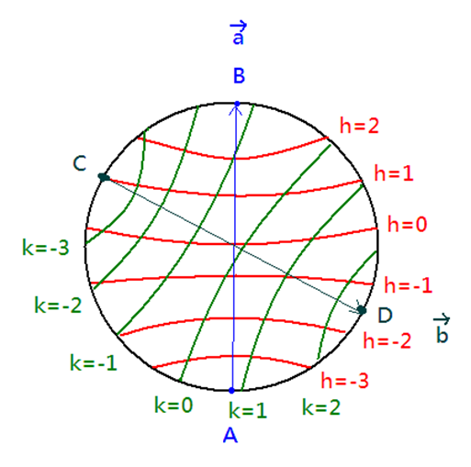
Stereographic projection for 2-D crystals
The lines of intersection of cones are labeled as (h , k)

Slide 19
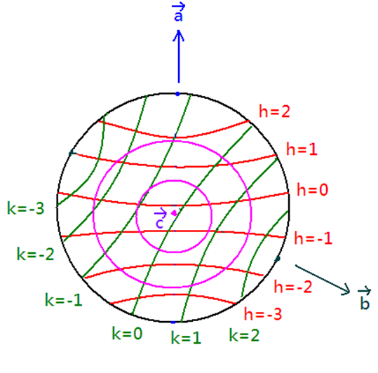
3rd Laue condition
l: integer
For a single crystal and a monochromatic wavelength, it is usually no diffraction to occur

Slide 20
(2) Laue photograph
Laue photograph is performed at “ single crystal and variable wavelength ”.
(2-1) Ewald sphere construction
or
white radiation : wavelength is continuoue;
lwl and swl: the longest and shortest wavelength in the white radiation.

Slide 21
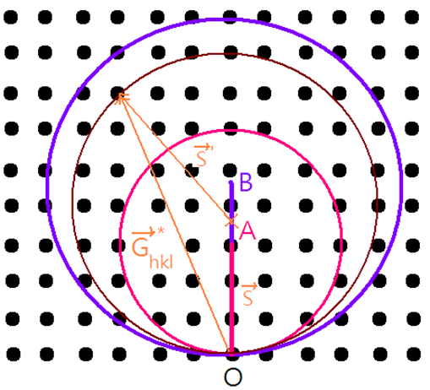
Two Ewald spheres of radius OA and OB form
in between two spherical surface meets the diffraction condition since the wavelength is continuous in white radiation.

Slide 22
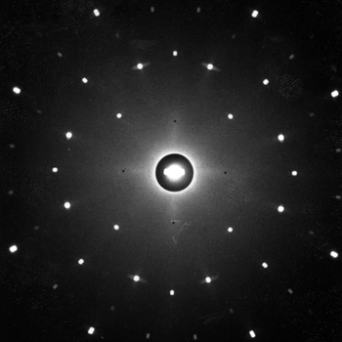
http://www.xtal.iqfr.csic.es/Cristalografia/archivos_06/laue1.jpg

Slide 23
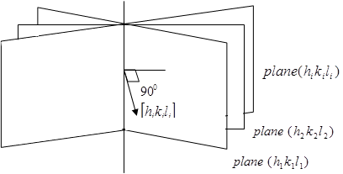
(2-2) zone axis
The planes belong to a zone
We define several planes belong to a zone [uvw], their plane normal [h_{i} k_{i} l_{i}] are perpendicular to the zone axis, In other words,

Slide 24
In the Laue experiments, all the planes meet the diffraction criterion. Each plane meets the 3 Laue conditions.
for all the plane belonged to the zone [uvw].

Slide 25
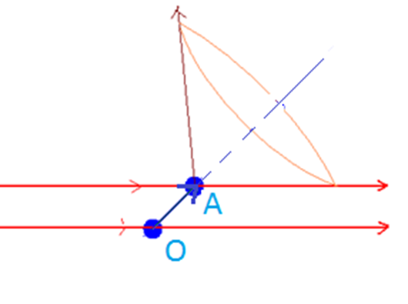
If we define
The path difference between the waves equals to

Slide 26
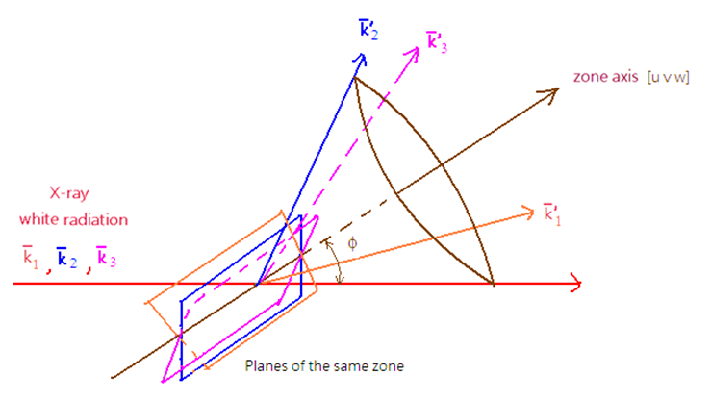
(A) for the condition φ < 45º
For all the planes (h_{i}k_{i}l_{i}) in the same zone [uvw]

Slide 27
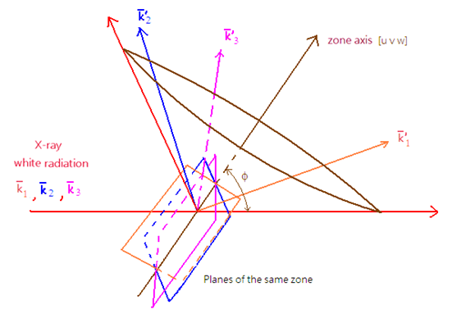
Therefore, all the diffracted beam directions Ŝ₁', Ŝ₂', Ŝ₃', …Ŝ_{i}' are on the same cone surface.
(B) for the condition φ > 45º
The same as well

Slide 28
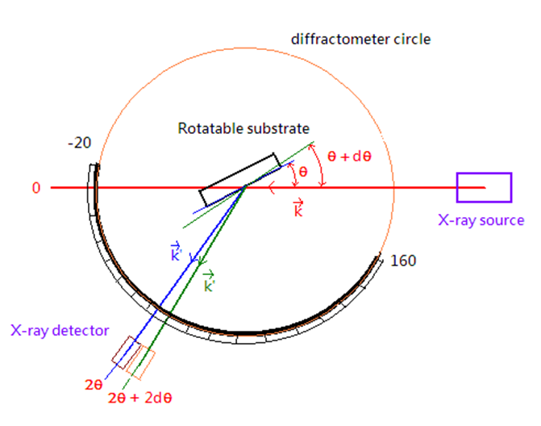
    9-2-2 Diffractometer method

Slide 29
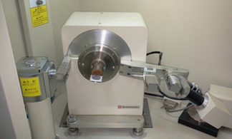
Instrumentation at MSE, NTHU
Shimatsu XRD 6000

Slide 30
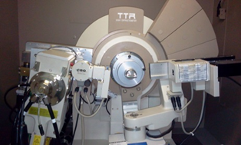
Rigaku TTR

Slide 31
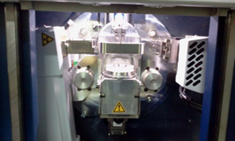
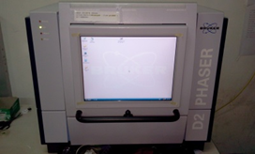
Bruker D2 phaser

Slide 32

9-2-2-1 θ-2θ scan

Slide 33
If a new material is deposited on Si(100) and put on the substrate holder in the diffractometer set-up, is always parallel to the Si(100) surface normal.
Any sample
θ₂
θ₁

Slide 34
Ewald sphere construction
2θ₁
θ₁
o
Si (100) substrate
Rotate the incident beam at until meets the diffraction condition at

Slide 35
This is equivalent to at least one crystal with
(h₁k₁l₁) plane normal in parallel with the
Si(100) surface normal.
When the incident beam is rotated (rotating
the Ewald sphere or rotating the reciprocal
lattice), will meet the diffraction
condition at
2θ₂
θ₁
θ₂
o
Si (100) substrate

Slide 36
This is equivalent to at least one crystal with
(h₂k₂l₂) plane normal in parallel with the
Si(100) surface normal.
If only one plane of the film is observed in the diffractometer measurement, the film is epitaxial or textured on Si(100).

Slide 37
(b) XRD spectrum of AlN deposited on Si(100)
A large number of grains with AlN(002) surface normal in parallel to Si(100) surface normal, but small amount of grains of AlN(100) and AlN(101) are also in parallel to Si(100) surface normal.

Slide 38
9-2-2-2 X-ray rocking curve
X-ray rocking is usually used to characterize the crystal quality of an epitaxial or textured film.
At a certain diffraction condition
the incident and outgoing directions of X-ray are fixed and the sample is rotated by θ scan.
Careful scan around a specific diffraction
peak!

Slide 39
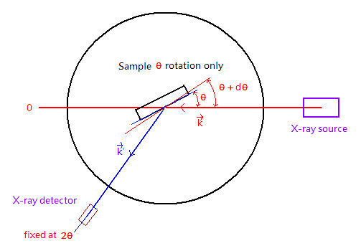
When the crystal is rotated by dθ, this is equivalent
to the detector being moved by the same dθ. (?) The FWHM of the diffracted peak truly reflects the
width of each reciprocal lattice point, i.e. the
shape effect of a crystal. (by high resolution!)

Slide 40
2θ
o
2(θ+Δθ)
o

Slide 41
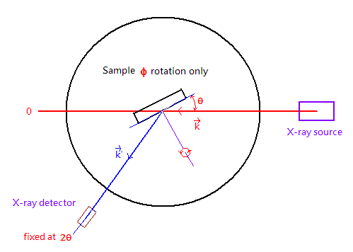
9-2-2-3. φ Scan
The φ scan is used to characterize the quality of the epitaxial film around its plane normal by rotating φ (0-2π)
φ

Slide 42
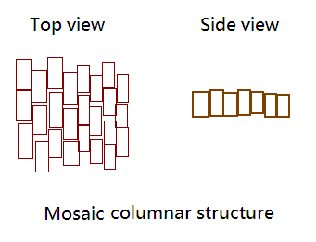
Example: the crystal quality of highly oriented grains each of which is a columnar structure shown below
Each lattice point in the reciprocal lattice will be expanded into an orthorhombic volume according to the shape effect. The scan can be used to confirm the orientation of the columnar structure relative to the substrate.

Slide 43
Shape effect
(
)
Reciprocal
lattice points
grain
2θ
2θ

Slide 44
2θ
0
φ
360

Slide 45
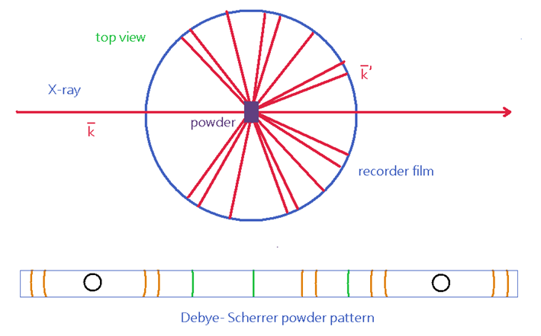
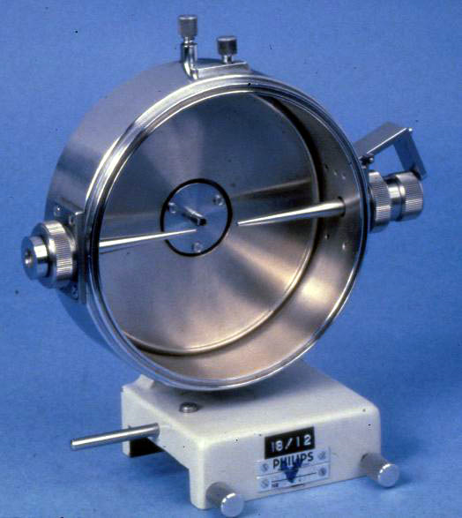
9-2-4 Powder method (Debye-Scherrer Camera)
http://www.adias-uae.com/plaster.html

Slide 46
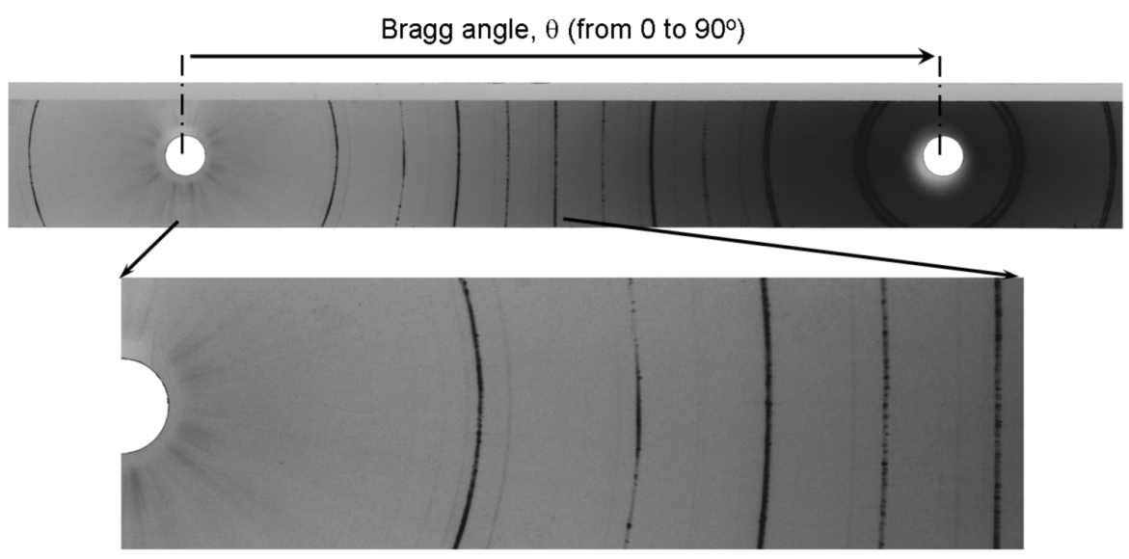
http://www.stanford.edu/group/glam/xlab/MatSci162_172/LectureNotes/06_Geometry,%20Detectors.pdf

Slide 47
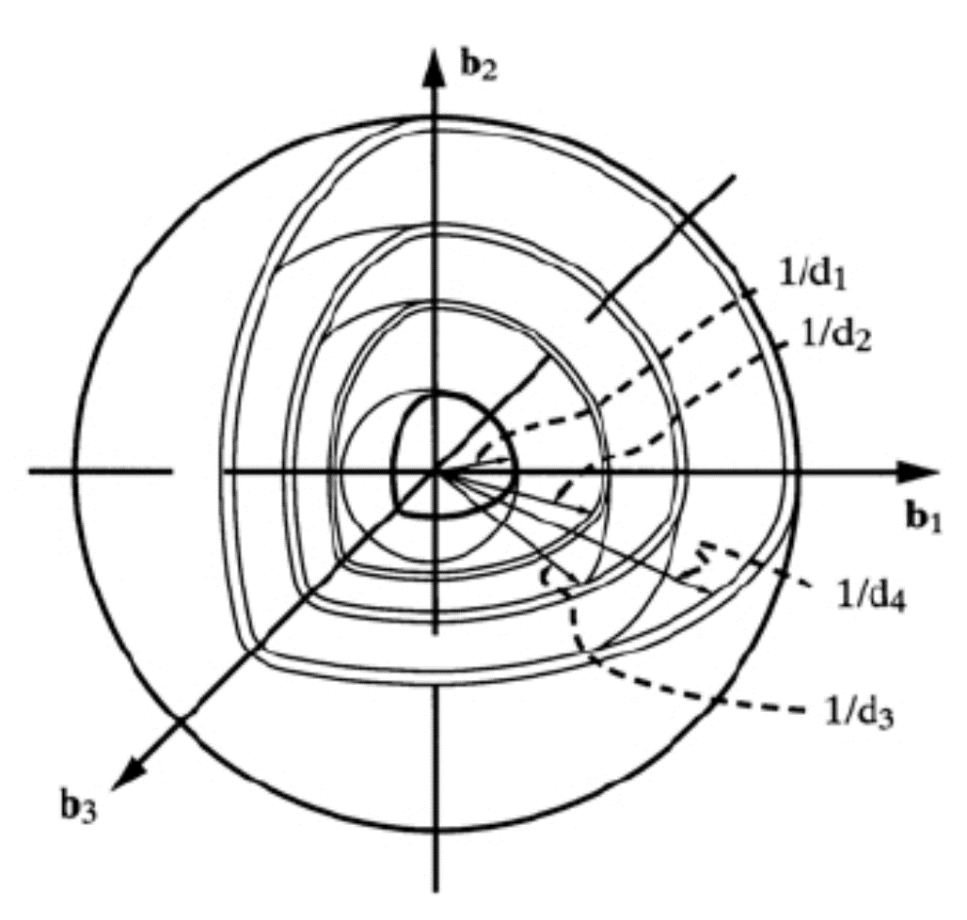
(a) Ewald sphere construction
Reciprocal lattice of a polycrystalline
sample
B.D. Cullity
Powder can be treated as a very larger number of polycrystals with grain orientation in a random distribution
Reciprocal lattice become a series of concentric
spherical shells with as their radius

Slide 48
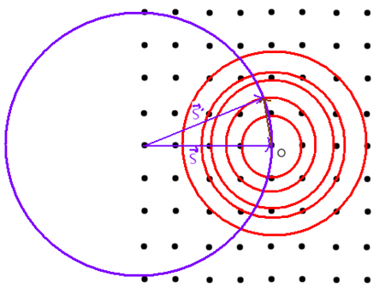
Intersection of Ewald
sphere with spherical
reciprocal lattice!
forms a cone resulting from the intersection between Ewald sphere and the spherical reciprocal lattice.
The intersection between the concentric spherical shells of in radius and the Ewald sphere of radius are a series of circles (recorded as lines in films)

Slide 49
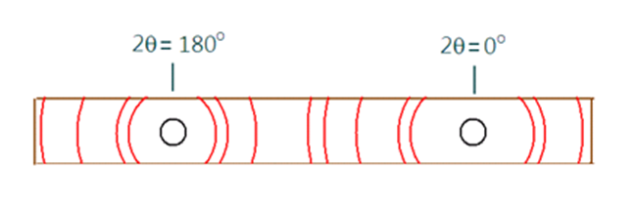
Example
Debye-Scherrer powder pattern of Cu made with Cu K_{α} radiation

Slide 50
1 | 2 | 3 | 4 | 5 | 6 | 7 | 8
line | hkl | h²+k²+l² | sin²θ | sinθ | θ (º) | sinθ/λ(Å⁻¹) | f_{Cu}
1 2 3 4 5 6 7 8 | 111 200 220 311 222 400 331 420 | 3 4 8 11 12 16 19 20 | 0.1365 0.1820 0.364 0.500 0.546 0.728 0.865 0.910 | 0.369 0.427 0.603 0.707 0.739 0.853 0.930 0.954 | 21.7 25.3 37.1 45.0 47.6 58.5 68.4 72.6 | 0.24 0.27 0.39 0.46 0.48 0.55 0.60 0.62 | 22.1 20.9 16.8 14.8 14.2 12.5 11.5 11.1

Slide 51
1 | 9 | 10 | 11 | 12 | 13 | 14
line | |F|² | P |  | Relative integrated intensity
 |  |  |  | Calc.(x10⁵) Calc. Obs.
1 2 3 4 5 6 7 8 | 7810 6990 4520 3500 3230 2500 2120 1970 | 8 6 12 24 8 6 24 24 | 12.03 8.50 3.70 2.83 2.74 3.18 4.81 6.15 | 7.52 3.56 2.01 2.38 0.71 0.48 2.45 2.91 | 10.0 4.7 2.7 3.2 0.9 0.6 3.3 3.9 | Vs S s s m w s s
111
200
220
311
222
400
331
420

Slide 52
(a) Structure factor (Cu: Fm-3m, a = 3.615 Å)
Four atoms at [000], [½ ½ 0], [½ 0 ½],
[0 ½ ½]

Slide 53
If h, k, l are unmixed
If h, k, l are mixed
(b)
Small θ is associated with small h²+k²+l².

Slide 54
Example: 111

Slide 55
0 0.1 0.2 0.3 0.4
29 27.19 23.63 19.90 16.48
p = 8
(2³ = 8)

Slide 56
(c) Multiplicity P is the one counted in the
point group stereogram.
In Cubic (h ≠ k ≠ l)
{hkl}
{hhl}
{0kl}
{0kk}
{hhh}
{00l}
P = 48
P = 24
P = 24
P = 12
P = 8
P = 6
(3x2x2³)
(3x2³)
(3x2x2²)
(3x2²)
(2³)
(3x2)
How about tetragonal?

Slide 57
(d) Lorentz-polarization factor
(i) polarization factor
The scattered beam depends on the angle of
scattering. Thomson equation
I₀: intensity of the incident beam
P
K: constant
r
e
α
α: angle between the scattering direction and the direction of acceleration of the electron

Slide 58
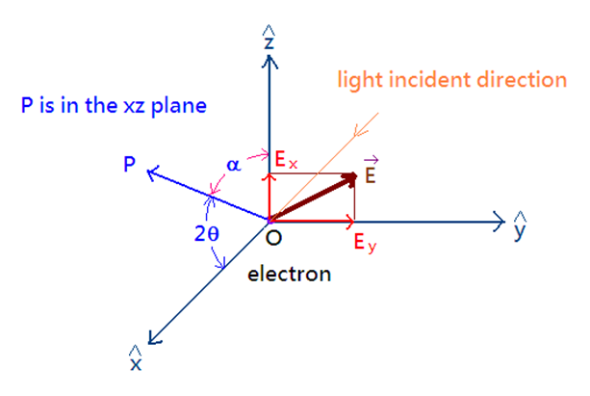
incident beam travel in direction
Random polarized beam →

Slide 59
The intensity at point P
y component
α = ∠yOP = π/2
z component
α = ∠zOP = π/2 -2θ
Polarization factor

Slide 60
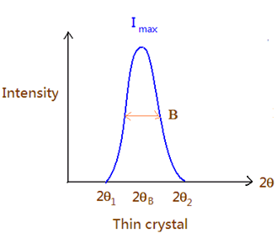
(ii) Lorentz factor
(ii-1)
factor due to grain orientation or crystal rotation
The factor is counted in powder method and in rotating crystal method.
First, the integrated
intensity

Slide 61
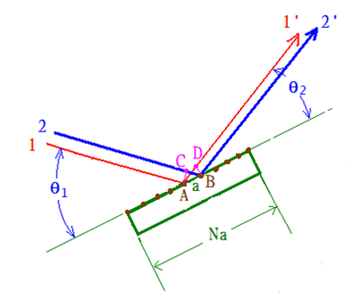
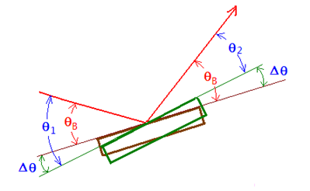
(a)
Crystals with reflection planes make an angle
θ_{B} with the incident beam → Bragg condition
met → intensity diffracted in the direction 2θ_{B}.
But, some other crystals are still diffracted in
this direction when the angle of incident
differs slightly from θ_{B}!

Slide 62
2θ
I_{max}
θ
I_{max}/2
θ₂
Intensity
B
2θ
Integrated
Intensity
θ_{B}
θ₁
2θ_{B}
Diffraction Angle 2θ
path difference for 11′-22′
= AD – CB = acosθ₂ - acosθ₁
= a[cos(θ_{B}-Δθ) - cos (θ_{B}+Δθ)]
= 2asin(Δθ)sinθ_{B} ~ 2aΔθ sinθ_{B}.
2
1′
2′
C
D
θ₁
θ₂
a
A
B
1′
2NaΔθ sinθ_{B} = λ → completely
cancellation (1- N/2, 2- (N/2+1) …)
N′
Na
Maximum angular range of the peak

Slide 63
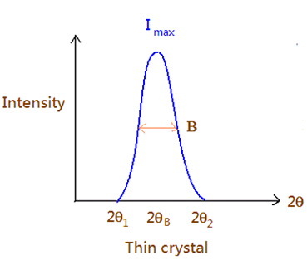
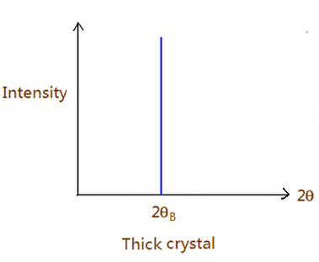
(b)
the width B increases as the thickness of the crystal decreases , as shown in the figure in the next page

Slide 64
Constructive Interference
θ + Δθ
θ
θ
0
1
2
t = md_{hkl}
…
…
θ + Δθ
θ → θ + Δθ
λ → λ + Δλ.
θ
θ
m
…
Destructive interference:
extra path difference (plane 0 and plane m/2): λ/2

Slide 65
Δθ << 1s → cosΔθ ~ 1 and sinΔθ ~ Δθ.
= t
Broadening (B): FWHM
Thickness dependent (just like slits)

Slide 66
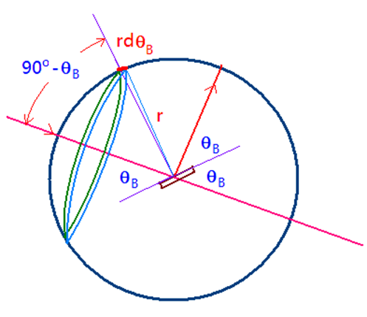
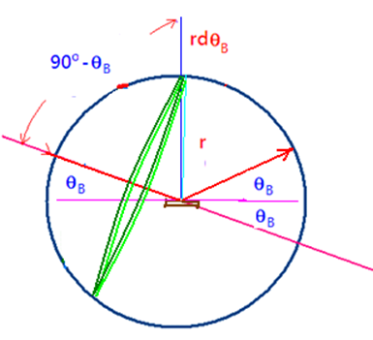
(iii-1) :factor due to the number of crystal counted in the powder method
The number of crystal is not constant for a
particular θ_{B} even through the crystal are oriented completely at random.

Slide 68
For the hkl reflection, the range of angle near the Bragg angle, over which reflection is appreciable, is Δθ. Assuming that ΔN is the number of crystals located in the circular band of width rΔθ.
# of grains satisfying the diffraction condition ∝ cosθ_{B}.
→ more grains satisfying the diffraction condition at higher θ_{B}.

Slide 69
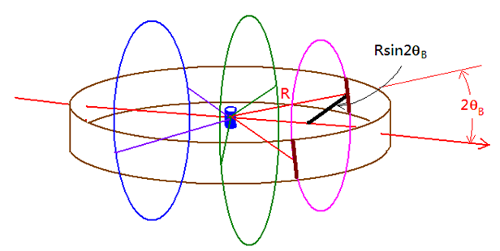
(iii-2) factor due to the segment factor in the Debye-Scherrer film
The film receives a greater proportion of a diffraction cone when the reflection is in the forward or backward direction than it does near

Slide 70
The relative intensity per unit length is proportional to
i.e. proportional to
Therefore, the Lorentz factor for the powder method is
and for the rotating crystal method and the diffractometer method is

Slide 71
(iv) Plot of polarization and Lorentz factors

